Slide 1
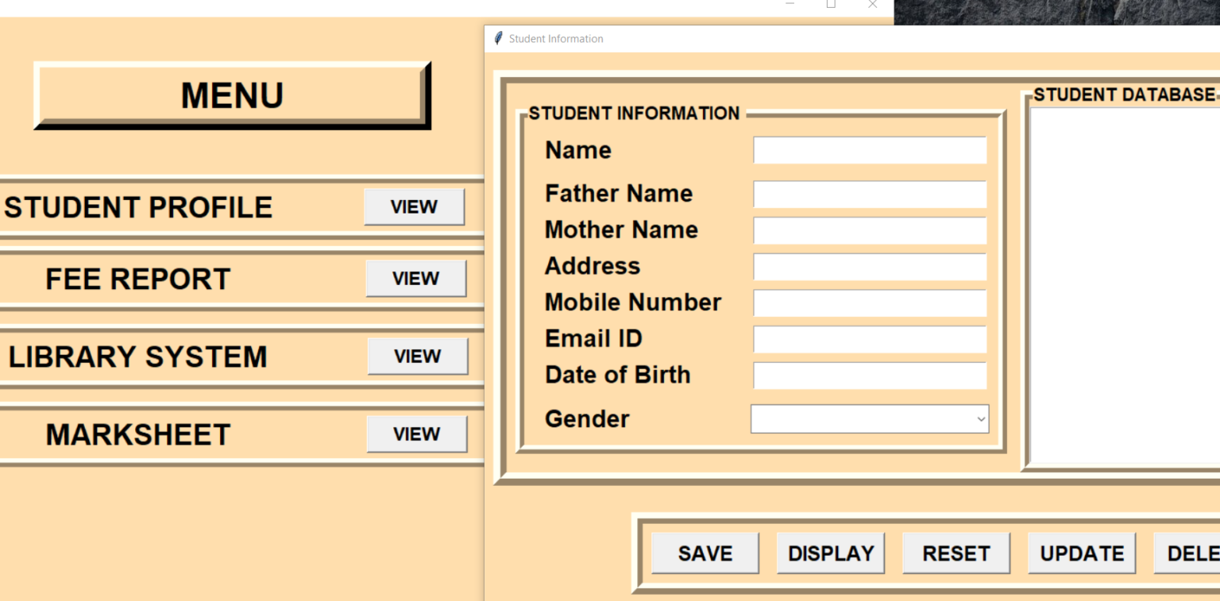
Diet E-Mentance App
Submitted as a partial fulfillment of the requirements of the award of the degree of B.Tech in CSE
Submitted By:
Jeevan kumar
Chandan kumar Meraj Alam

Slide 2
Introduction
The project contains only the admin side. It is an integrated console-based application that handles various academic activities of a College.

Slide 3
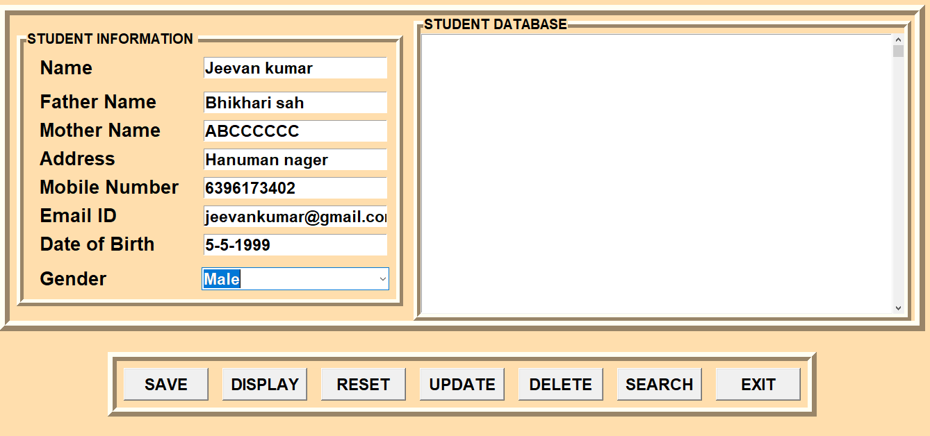
Student Profile:

Slide 4
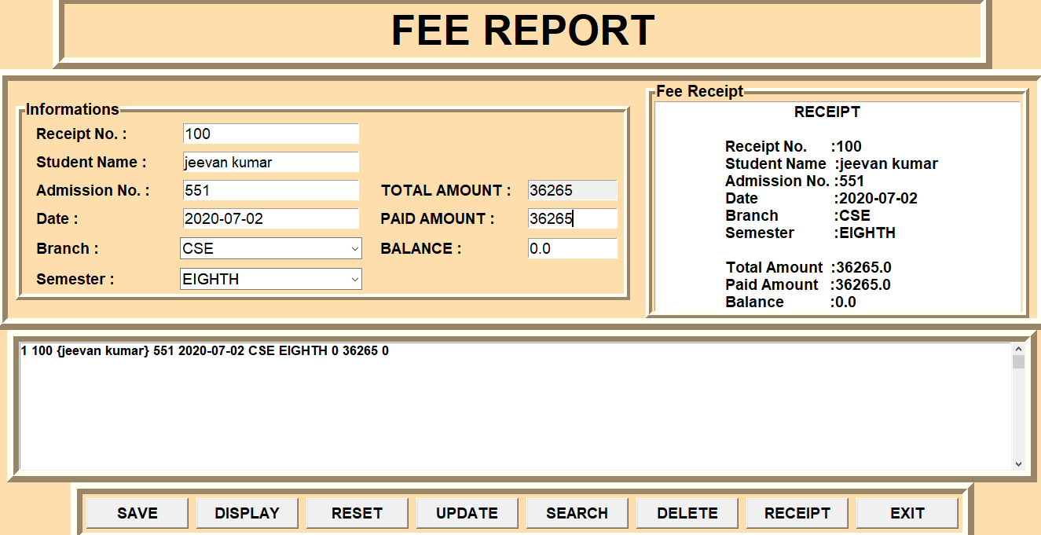
Fee Report:

Slide 5
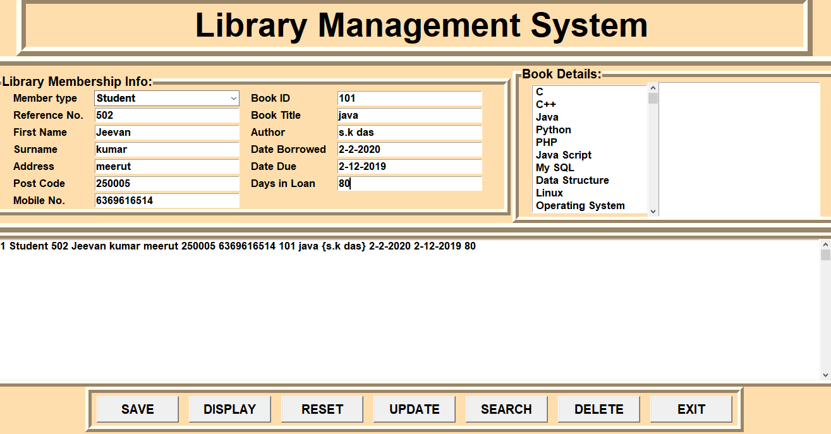
Library System :

Slide 6
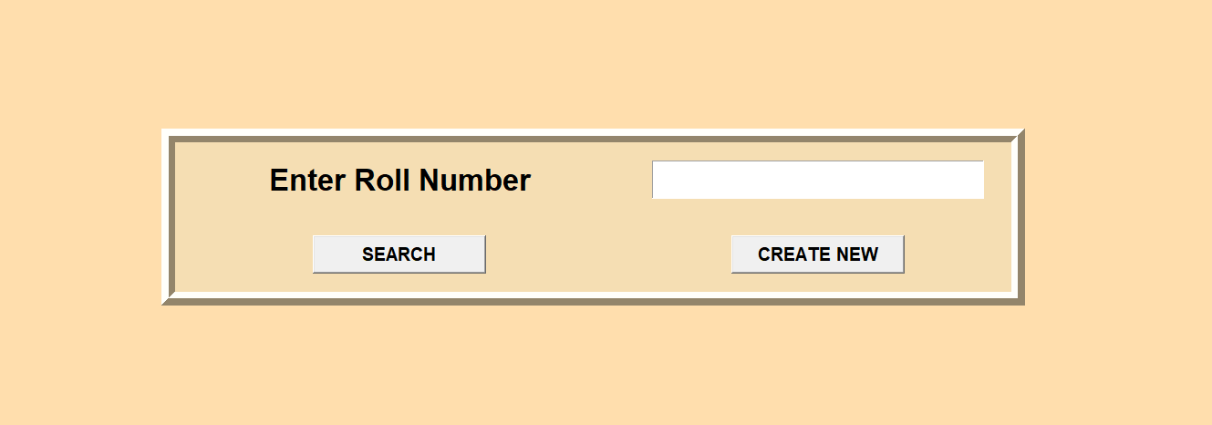
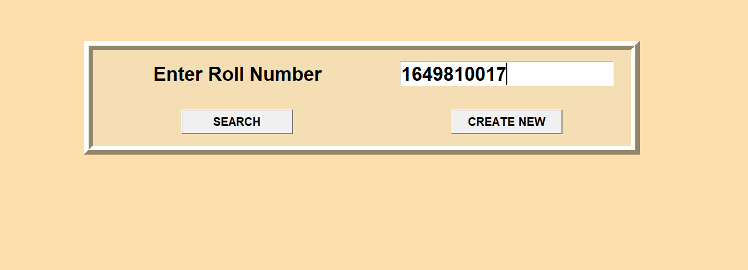
Marksheet :

Slide 7
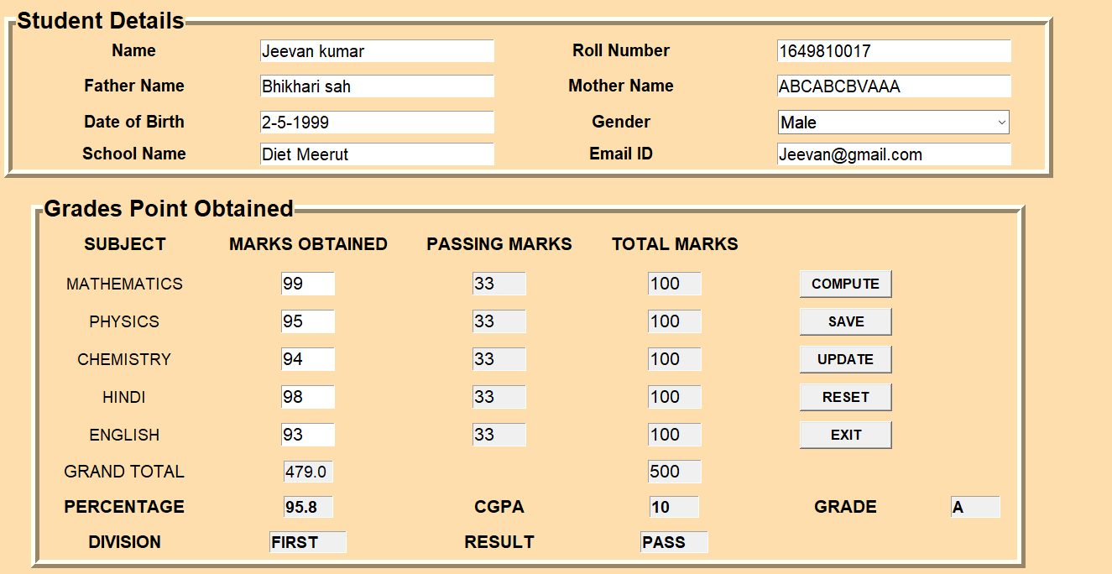
Here to Create New Roll Number :

Slide 8
FUTURE SCOPE OF THE PROJECT : To easy to manage all students records To easy to use this app Easy to mentanances All information available in one app

Slide 9


